Slide 1
Youthpass – makes learning visible
November 2022

Slide 2
„Let’s talk about Youthpass“ – watch the video on Youtube
For more Youthpass videos, check: www.youthpass.eu/en/about-youthpass/video

Slide 3
Youthpass – More than a paper!
Notes:
An empowering certificate of participation and, more importantly, of learning outcomes & developed competences.
A process that accompanies the participants throughout the project lifecycle and helps them reflect on their learning in European youth and solidarity projects.
A strategy to support young people and youth workers through a better recognition of learning in European youth work.
For more information on Youthpass: https://www.youthpass.eu/en/about-youthpass/about/

Slide 4
Youthpass is a…
European instrument for participants of projects funded by the youth part of Erasmus+ and the European Solidarity Corps programmes. It is both for young people and youth workers as learners.
For all learners in the programmes (except DiscoverEU for now)​
Multilingual (with the support of National Agencies)

Slide 5
Underlying principles of Youthpass
Voluntary for participants*
Dialogue process
Self-assessment and certificate
*Organisations need to be well informed to adequately present Youthpass to participants
Notes:
It is based on self-assessment that leads to a certificate
Ideally, it involves a dialogue process between the learner and the facilitators of learning throughout a project
It is voluntary for participants, however the participants need to be motivated and encouraged by facilitators of learning (and/or by project organisers) to reflect on their learning. This means that the organisations need to be well informed to adequately present it to the participants
The time and the methodology for reflection on learning is a quality aspect in projects.

Slide 6
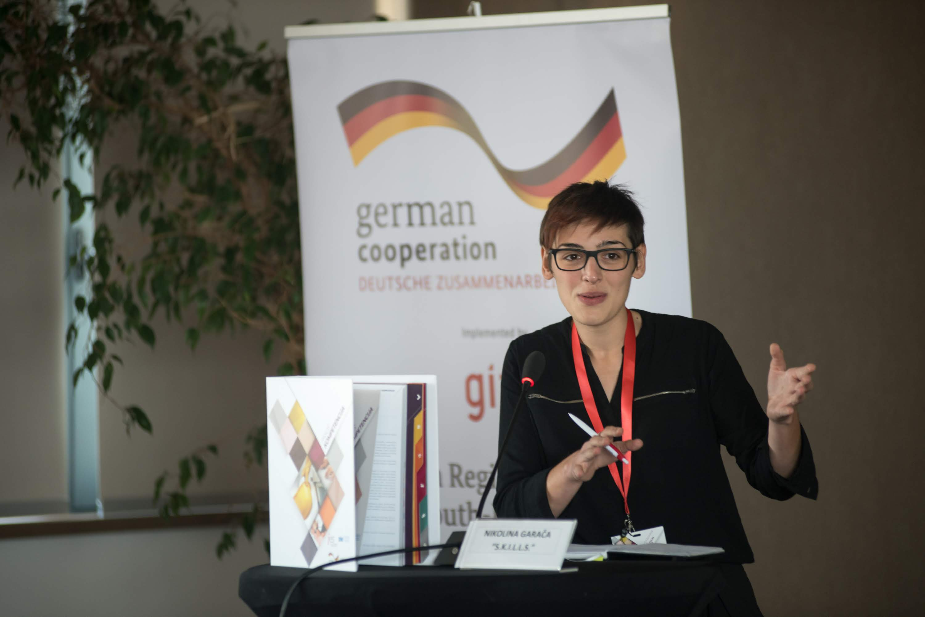
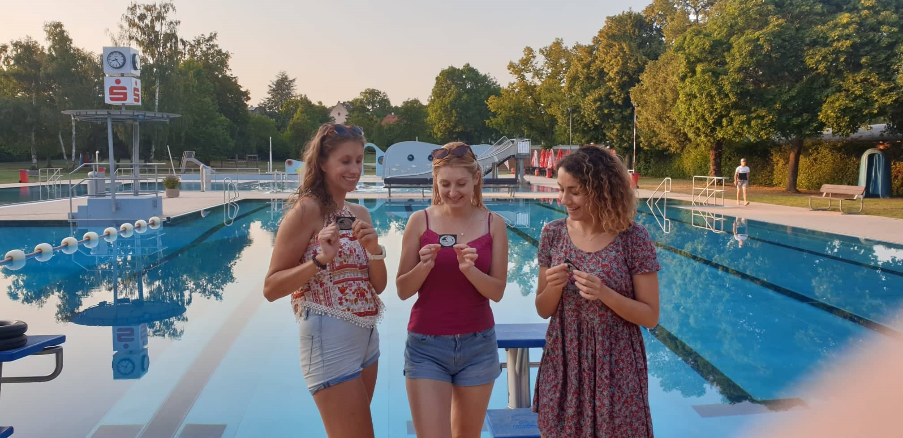
Why Youthpass?
"What I tried to portray in this story is a path I took from gaining my first Youthpass to gaining a few more, learning and growing through non-formal education, being able to secure jobs and scholarships for myself and, finally, discover my inner passion and find my dream job. To everyone second-guessing themselves: don’t. Try! There is nothing to lose, and so, so much to gain. Thanks, Youthpass!" - Nikolina Garača
"With the help of Youthpass and my mentor, I started to believe in myself, see my potential to grow and reached my goal. I believe that was just a small piece of a puzzle in the big picture of success, but now I see how Youthpass can help me to achieve much more in my future career and personal life." – Vanja Bunderla
Notes:
For more testimonials, see: https://www.youthpass.eu/en/about-youthpass/1million-youthpasses/

Slide 7
As a process:
Putting and keeping learning on the agenda​
​
Supporting reflection on the experience​
​
Keeping track of and recording the learning journey and its outcomes​
​
Naming learning and competences​
​
Certificate with description of learning ​
Ideally supported by a facilitator of learning
Notes:
For more information on the Youthpass process, check the relevant parts of Youthpass Unfolded handbook: https://www.youthpass.eu/en/publications/youthpass-unfolded/

Slide 8
Youthpass in numbers
Since its launch in 2007 and by the beginning of 2021, some 1.380.000 Youthpass certificates have been created in over 80.000 projects by more than 30.000 organisations
According to the RAY Network survey results*
…89% of the participants who had the Youthpass process implemented in their project confirmed that the reflection on learning and the self-assessment helped raise their awareness of their development
…67% of Youthpass receivers who used it in job, internship or study applications think that it was helpful in that process
*RAY-MON Comparative Research Report (2022). Effects and outcomes of the Erasmus+ Youth in Action Programme 2014-2020. Transnational Analysis. https://www.researchyouth.net/wp-content/uploads/2022/01/RAY-MON_Research-Report-20142020.pdf

Slide 9
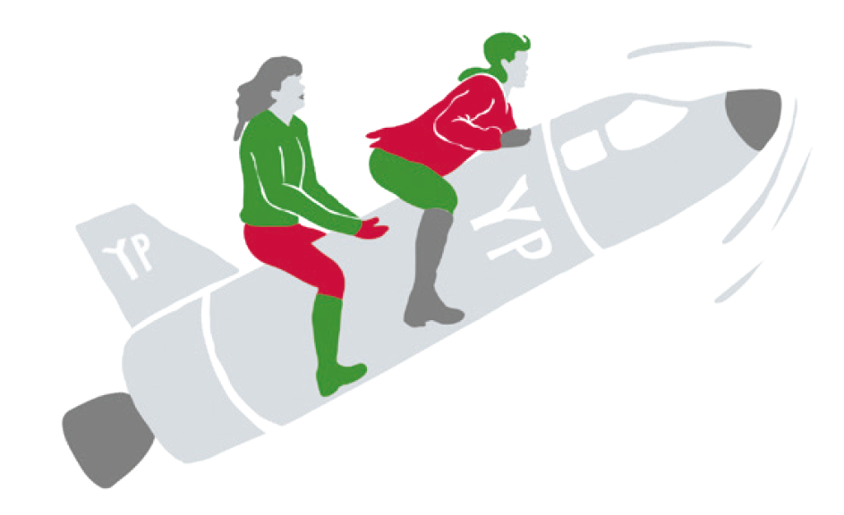
Youthpass Strategy
Vision:
Broad visibility and understanding
of the learning value of the youth field,
and of the competences developed
through involvement in the youth field.
www.youthpass.eu/en/about-youthpass/youthpass-strategy ​

Slide 10
Objectives
Strengthen the recognition and validation of non-formal and informal learning
Amplify the visibility and recognition of the learning value of youth work
Set the direction for the further development of Youthpass and reinforce its quality implementation
Inform and support relevant policy processes and make systemic efforts
/

Slide 11
Field of Action 3:
Policy Support
Field of Action 2:
Learning and Recognition
Field of Action 1:
Implementation and further development of Youthpass

Slide 12
New Youthpass certificates!

Slide 13
New Youthpass certificates
Background considerations
Better alignment with the setup of the 2 programmes: Focus on the whole project, not single activity
More emphasis on learning
More flexibility in the setup
More similarity across formats
Accessibility
Support also to online contexts
Available also for team members
Attention on needs regarding validation

Slide 14
Actions and certificate types
Youth Exchange |  | Youth Exchange
Youth Worker Mobility TCA NET TEC for organisations |  | Certificate for “youth workers”
Youth Participation Activities |  | Youth Participation Activities
DiscoverEU |  | Not available yet
KA1 Accredited projects, in case many activities of different type KA2 Small-scale and Cooperation Partnerships KA2 Capacity Building KA3 European Youth Together |  | “General” Youthpass certificate
Volunteering (individual and teams) Humanitarian Aid Volunteering Projects |  | Volunteering
Solidarity Projects |  | Solidarity Projects

Slide 15
3 parts
Brief general information, incl. project description and individual tasks
Learning context and outcomes (optional)
Project context (a „transcript“, optional)
Partly independent from each other: the general information can be issued on its own, or together with learning outcomes, and/or together with project details.

Slide 16
New elements on the certificates
Available also for team members („… contributed as a youth leader to...“)
Possibility to list evidence for the learning outcomes
The whole transcript (third part called ‚Project Context‘)
Includes among others: length of involvement
Especially relevant for complex projects including multiple activities
For youth workers’ and team members’ certificates: ETS competence model for youth workers is used

Slide 17
Frameworks used for self-assessment of competences
For youth workers as learners and for team members
European Training Strategy competence model for youth workers to work internationally
For young people as learners
Framework of the Key Competences for Lifelong Learning

Slide 18
The ETS competence model on Youthpass
Facilitating learning
Designing programmes
Managing resources
Collaborating in teams
Communicating meaningfully
Displaying intercultural sensitivity
Networking and advocating
Assessing and evaluating
Being civically engaged
Other competences

Slide 19
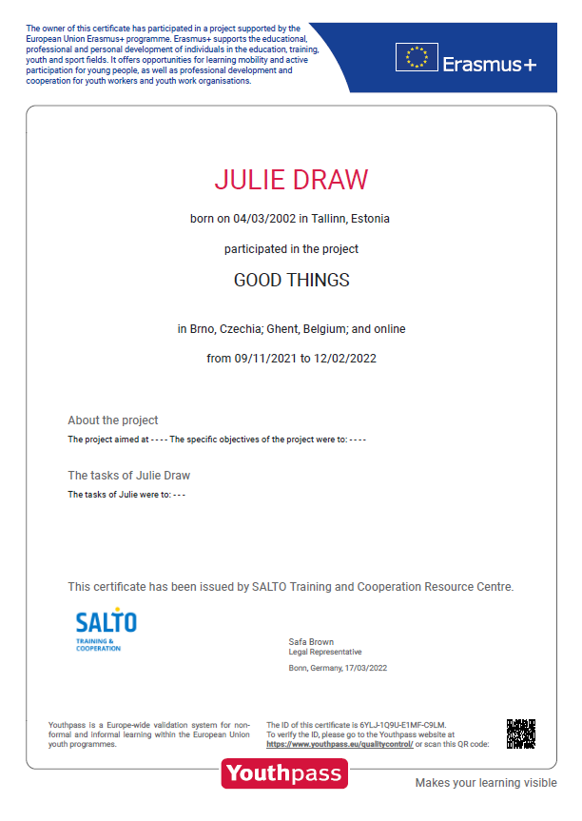
Youthpass certificate: I part
Confirmation of participation
Data of participant
Brief general information about the project
Signature
*Example certificate for Erasmus+ Youth Participation Activity - first page
Notes:
The information, fields, standard texts and visual identity varies among certificates for Erasmus+ and European Solidarity Corps and where relevant, among different activity types
Example certificates for different activities can be seen at https://www.youthpass.eu/en/help/demo-certificates/

Slide 20
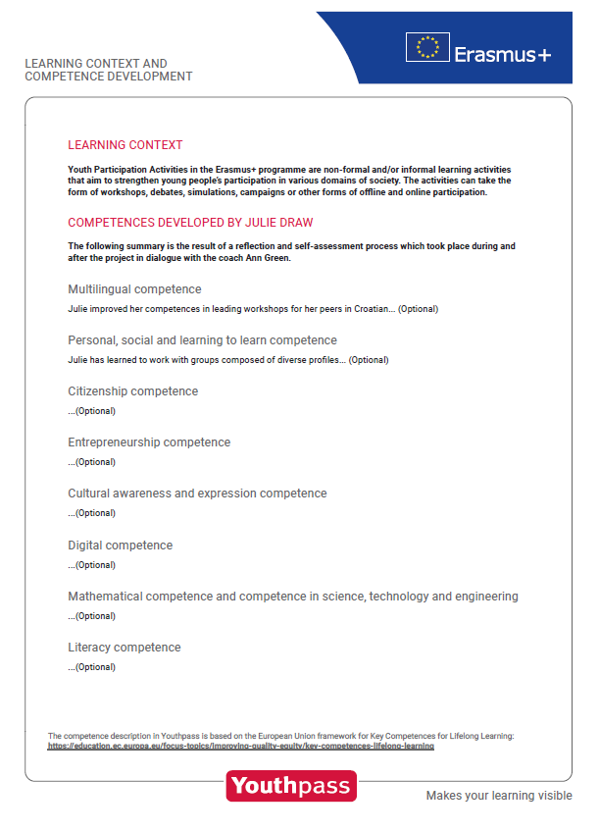
Youthpass certificate: II part
Learning context and outcomes
Explanation of the learning context
Explanation of the self-assessment and the dialogue process
Description of learning results
Other competences
Signature of the learner, also dialogue partner if applicable
Further evidence for learning
References (up to 2)
*Example certificate for Erasmus+ Youth Participation Activities second page
Notes:
The information, fields, standard texts and visual identity varies among certificates for Erasmus+ and European Solidarity Corps, and where relevant, among different activity types
Example certificates for different activities can be seen at https://www.youthpass.eu/en/help/demo-certificates/

Slide 21
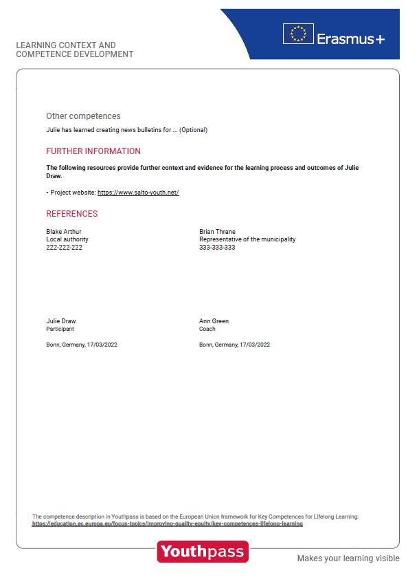
Youthpass certificate: II part (continued)
*Example certificate for Erasmus+ Youth Participation Activities second page
Notes:
The information, fields, standard texts and visual identity varies among certificates for Erasmus+ and European Solidarity Corps, and where relevant, among different activity types
Example certificates for different activities can be seen at https://www.youthpass.eu/en/help/demo-certificates/

Slide 22
Youthpass certificate: III part
Project context
Further (brief) information on each activity
This section is meant to be used for complex projects (that have multiple activities)
This section could be skipped for single activity projects to keep the certificate shorter
Possibility to describe further participation details (such as length of involvement, tasks etc)
*Example certificate for Erasmus+ Youth Participation Activities second page
Notes:
The information, fields, standard texts and visual identity varies among certificates for Erasmus+ and European Solidarity Corps, and where relevant, among different activity types
Example certificates for different activities can be seen at https://www.youthpass.eu/en/help/demo-certificates/

Slide 23
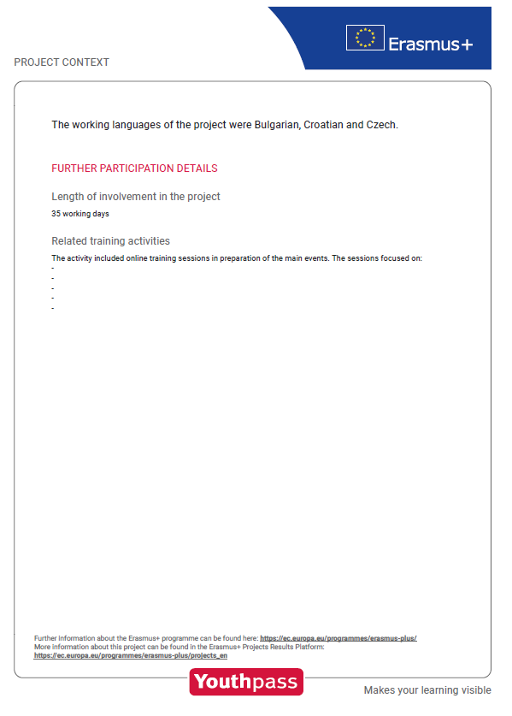
Youthpass certificate: III part (continued)
*Example certificate for Erasmus+ Youth Participation Activities second page
Notes:
The information, fields, standard texts and visual identity varies among certificates for Erasmus+ and European Solidarity Corps, and where relevant, among different activity types
Example certificates for different activities can be seen at https://www.youthpass.eu/en/help/demo-certificates/

Slide 24
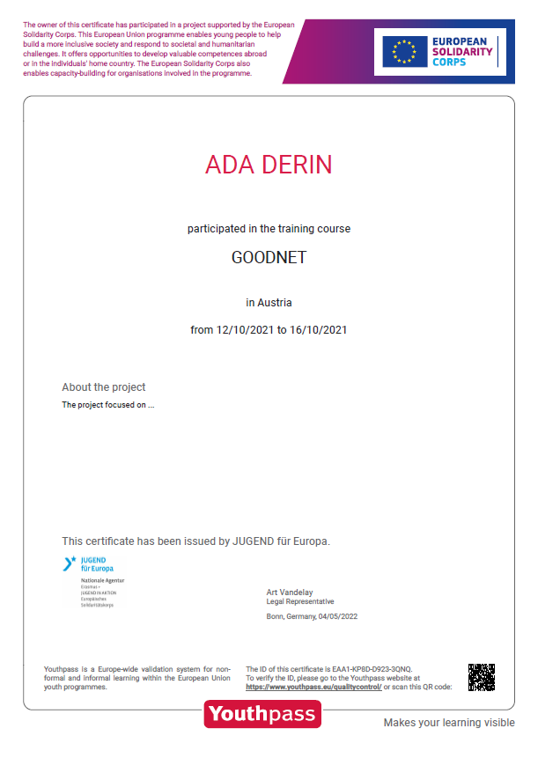
Youthpass certificate: European Solidarity Corps
*Example certificate for European Solidarity Corps NET activity
Notes:
The information, fields, standard texts and visual identity varies among certificates for Erasmus+ and European Solidarity Corps, and where relevant, among different activity types
Example certificates for different activities can be seen at https://www.youthpass.eu/en/help/demo-certificates/

Slide 25
Frequently asked questions on the new certificates
Step-by-step guide helps you understand the workflow of generating a Youthpass certificate
In addition, have a look at the FAQs for your specific questions on the new certificates:
How to use the demo website
Youthpass in the 2021-2027 programmes
Youthpass Automatic Notification System (YANS)
ETS Competence Model on Youthpass
Youthpass for team members
How to use the ‚Activities‘ tab on Youthpass
For more FAQs, check https://www.youthpass.eu/en/help/faqs/

Slide 26
Main plans for 2022-2023
Continue the conceptual and technical development of Youthpass
Certificates for DiscoverEU
Allow electronic signatures
Explore ‚learning in youth work‘ through specific activities
Enable learner accounts
More visibility through a communication strategy
Continue offering targeted support

Slide 27
Educational support
Videos
Let´s talk about Youthpass
Other 10 animated videos on Youthpass and learning
Leaflets
Tips on Youthpass in different types of projects
Information on Key Competences
Promotional material
Youthpass origami planes
Youthpass cat
Handbooks
One 2 One
Valued by You, Valued by Others
Youthpass Unfolded
Research reports
Training courses
One 2 One
Tuning In
Youthpass <3 Corps online course
More to Come in 2022-2023!
Workshops for trainers
Training for short-term group projects
Notes:
For Youthpass handbooks: https://www.youthpass.eu/en/publications/handbooks/ and for Youthpass leaflets: https://www.youthpass.eu/en/publications/leaflets/
For more information on regular Youthpass trainings: https://www.youthpass.eu/en/help/youthpass-trainings/

Slide 28
Youthpass Officers - YPOs
„Have the Youthpass hat on“
For Erasmus+ Youth and European Solidarity Corps
Support to the awareness about Youthpass and to its quality implementation on the national level
Analysing the usage of Youthpass on the national level
Supporting national/regional strategies for recognition for non-formal and informal learning
Supporting practitioners with educational offers (publications, training courses, support materials etc.)
Translation of the Youthpass website and certificates
Notes:
In some National Agencies there is one Youthpass Officer that is responsible for Youthpass implementation in both programmes. In other NAs there are 2 or more officers who are responsible for different programmes or key actions.

Slide 29
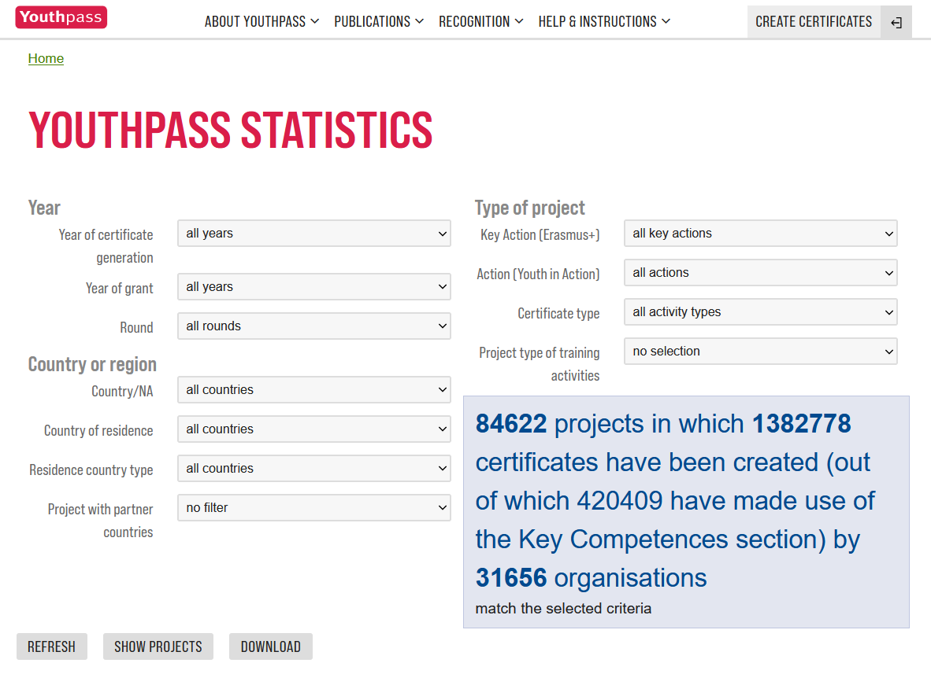
For more data on Youthpass
Statistics tool on the Youthpass website (available to YPO-s): https://www.youthpass.eu/en/youthpass/statistics/
2 sets of data per year offered by SALTO:
General overview at the beginning of the year
More detailed national figures during the period of work plan development
Other sources of information:
Final reports
EAC Dashboard
Special initiatives...
Notes:
Youthpass Officers (YPOs) of each National Agency can access the YPO space on the Youthpass website (under the Help & Instructions menu bar). Here it is possible to access overall and country-specific statistics around Youthpass. The statistics can be filtered per year, action/programme type, certificate type etc.
The other reports are published on Youthpass website and social media and also disseminated via YPOs.

Slide 30
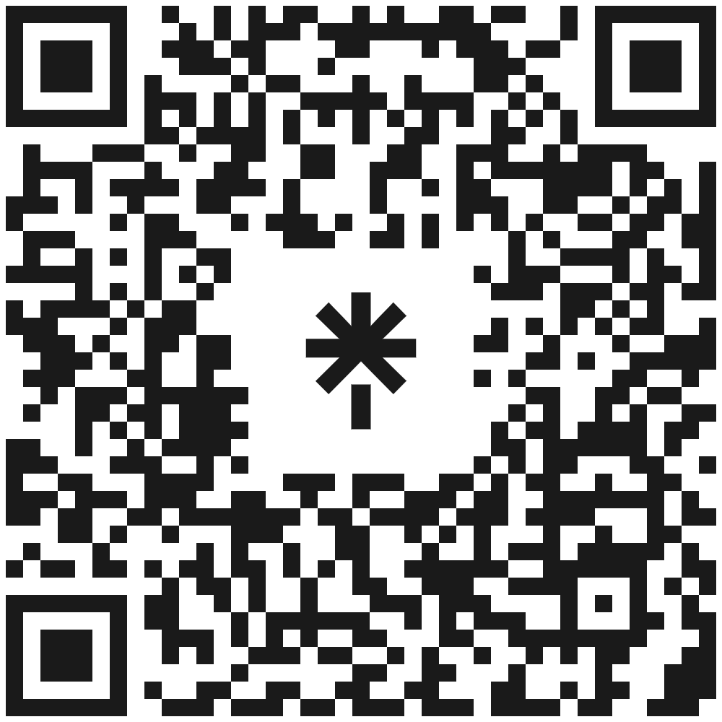
Further support and resources
SALTO Training & Cooperation Resource Centre is responsible for the technical and conceptual development of Youthpass and to develop the necessary training and support
Youthpass Helpdesk offers support to users of Youthpass both for technical and content-related questions. NA colleagues are also invited to report problems via the Helpdesk.
youthpass@salto-youth.net
On Youthpass demo website you can try out Youthpass
http://demo.youthpass.eu/en/login/
Follow Youthpass on social media to keep up-to-date
FB @Youthpass.eu
Twitter @Youthpass_eu
Instagram @Youthpass.eu
Youthpass news included in the monthly SALTO Newsletter
Subscribe @ https://www.salto-youth.net/

Slide 31
Questions for NA colleagues
How can the awareness of Youthpass and the related quality aspects in „my“ key action and area of work be supported?
How can we encourage that the learning aspect of Youthpass (self-assessment) is made use of?
Would there be ways to encourage the use of Youthpass after the projects?
Notes:
Some questions to help to open a discussion on the implementation of Youthpass.

Slide 32
Thank you for your attention!
www.youthpass.eu Contact via youthpass@salto-youth.net
Facebook: Youthpass and Recognition
Twitter: youthpass.eu
Instagram: youthpass.eu
Youtube: SALTO Training and Cooperation Resource Centre
Images by Joonmeedia.ee, Kreativraum.de and Zedem Media
32

